Slide 1

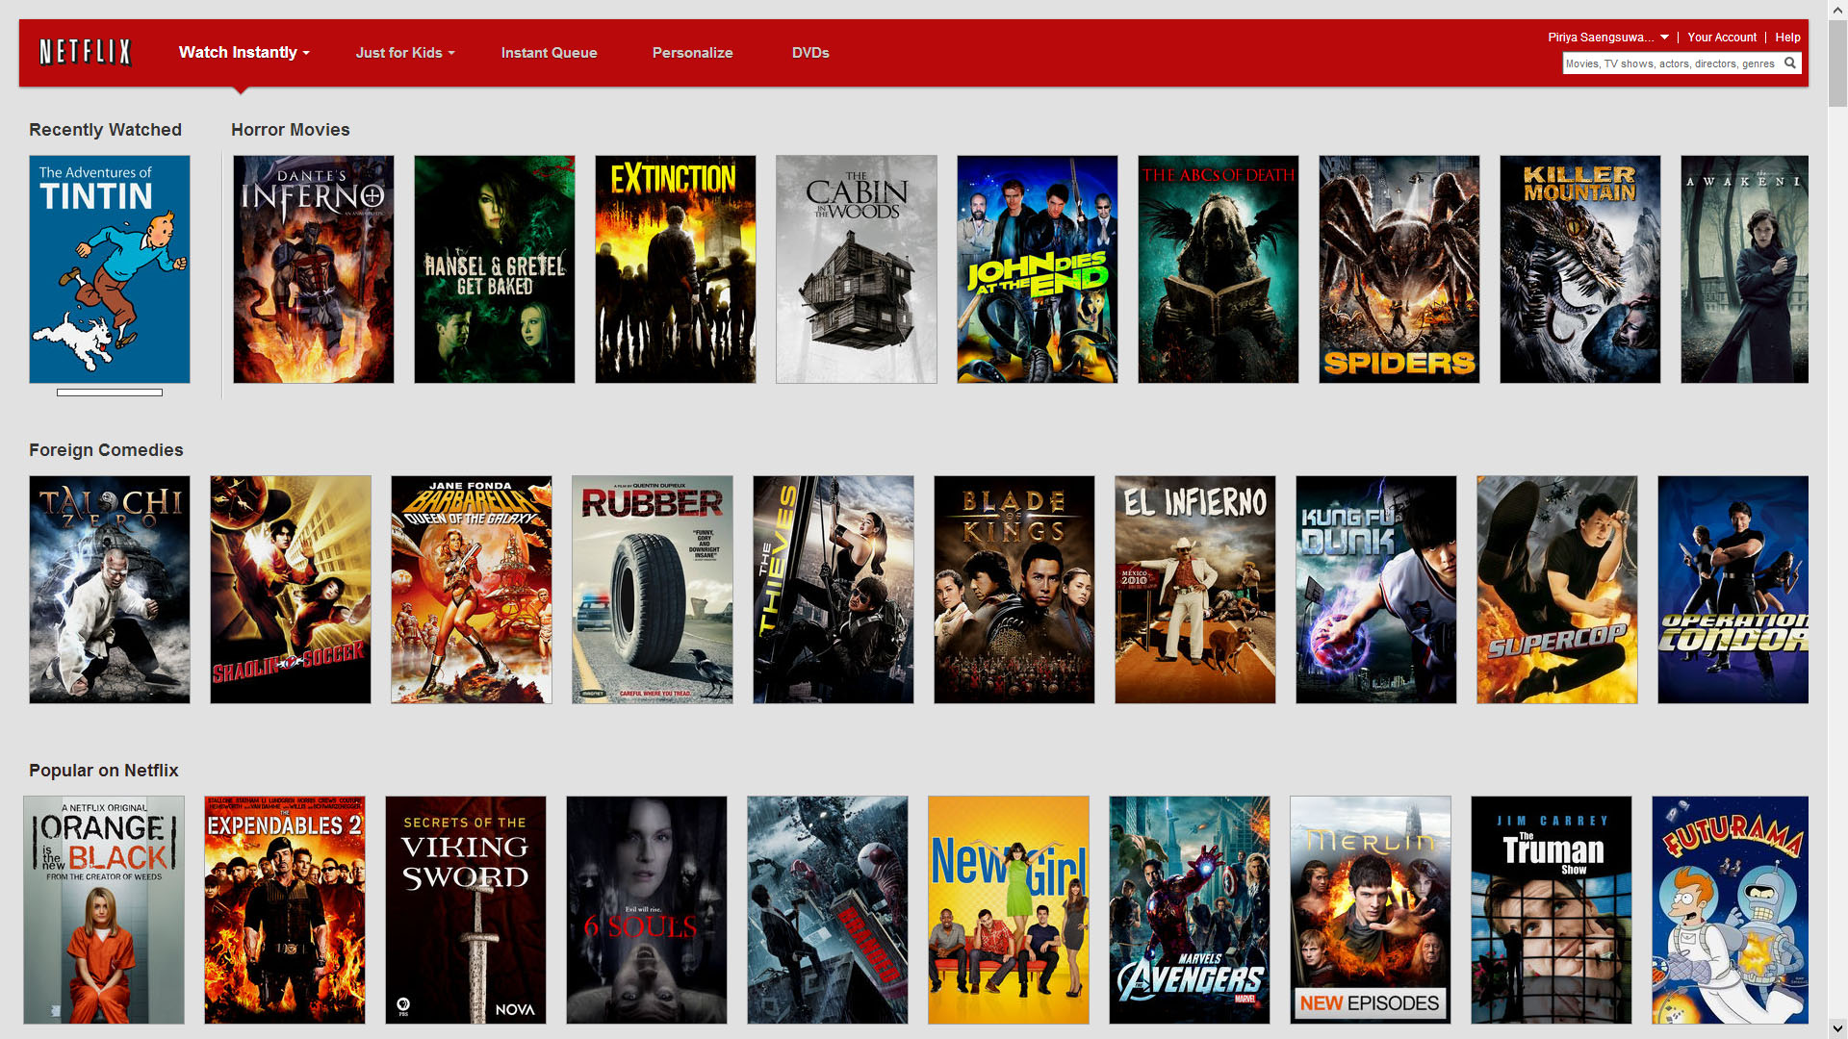
MOVIE Rental Store Database
INFO 240 Summer 2013
Piriya Saengsuwarn
Peifeng Jing
Mehdi JaagouB

Slide 2
Introduction

Slide 3

Initial business problems
Business Process Automation: Movie Rental Store
Renting Movies
Review Movies
Browse Movies by:
Genre
ReleaseDate
Etc.

Slide 4



DIGITAL CONTENT
CUSTOMER
INTERNET
SERVER
INTERNET
STORE OWNER

Slide 5

Additional/Modified business problems
Tracking conditions of movie rental items
BLURAY
DVD
Tracking release status of movies
Released
In production

Slide 6

PHYSICAL DISC
RENTAL STORE
CUSTOMER
INTERNET
SERVER
INTERNET
STORE OWNER

Slide 7
Database Users
Customer
Membership account information
Rental/order history
Movie searching and review
Store Owner
Item condition
Movie format
Tracking promotion

Slide 8
Challenges

Slide 9

Challenges Identifying Business Rules
Setting up business rules and following them
Rules kept changing
Conceptualizing rules
Starting as a streaming service and changing to renting physical copies

Slide 10

Challenges Visualizing ERD
Eliminating unnecessary referential loop
Determining additional associated entities
Simulating user interaction scenarios with database

Slide 11
Entity Relationship Diagrams Revisions

Slide 12
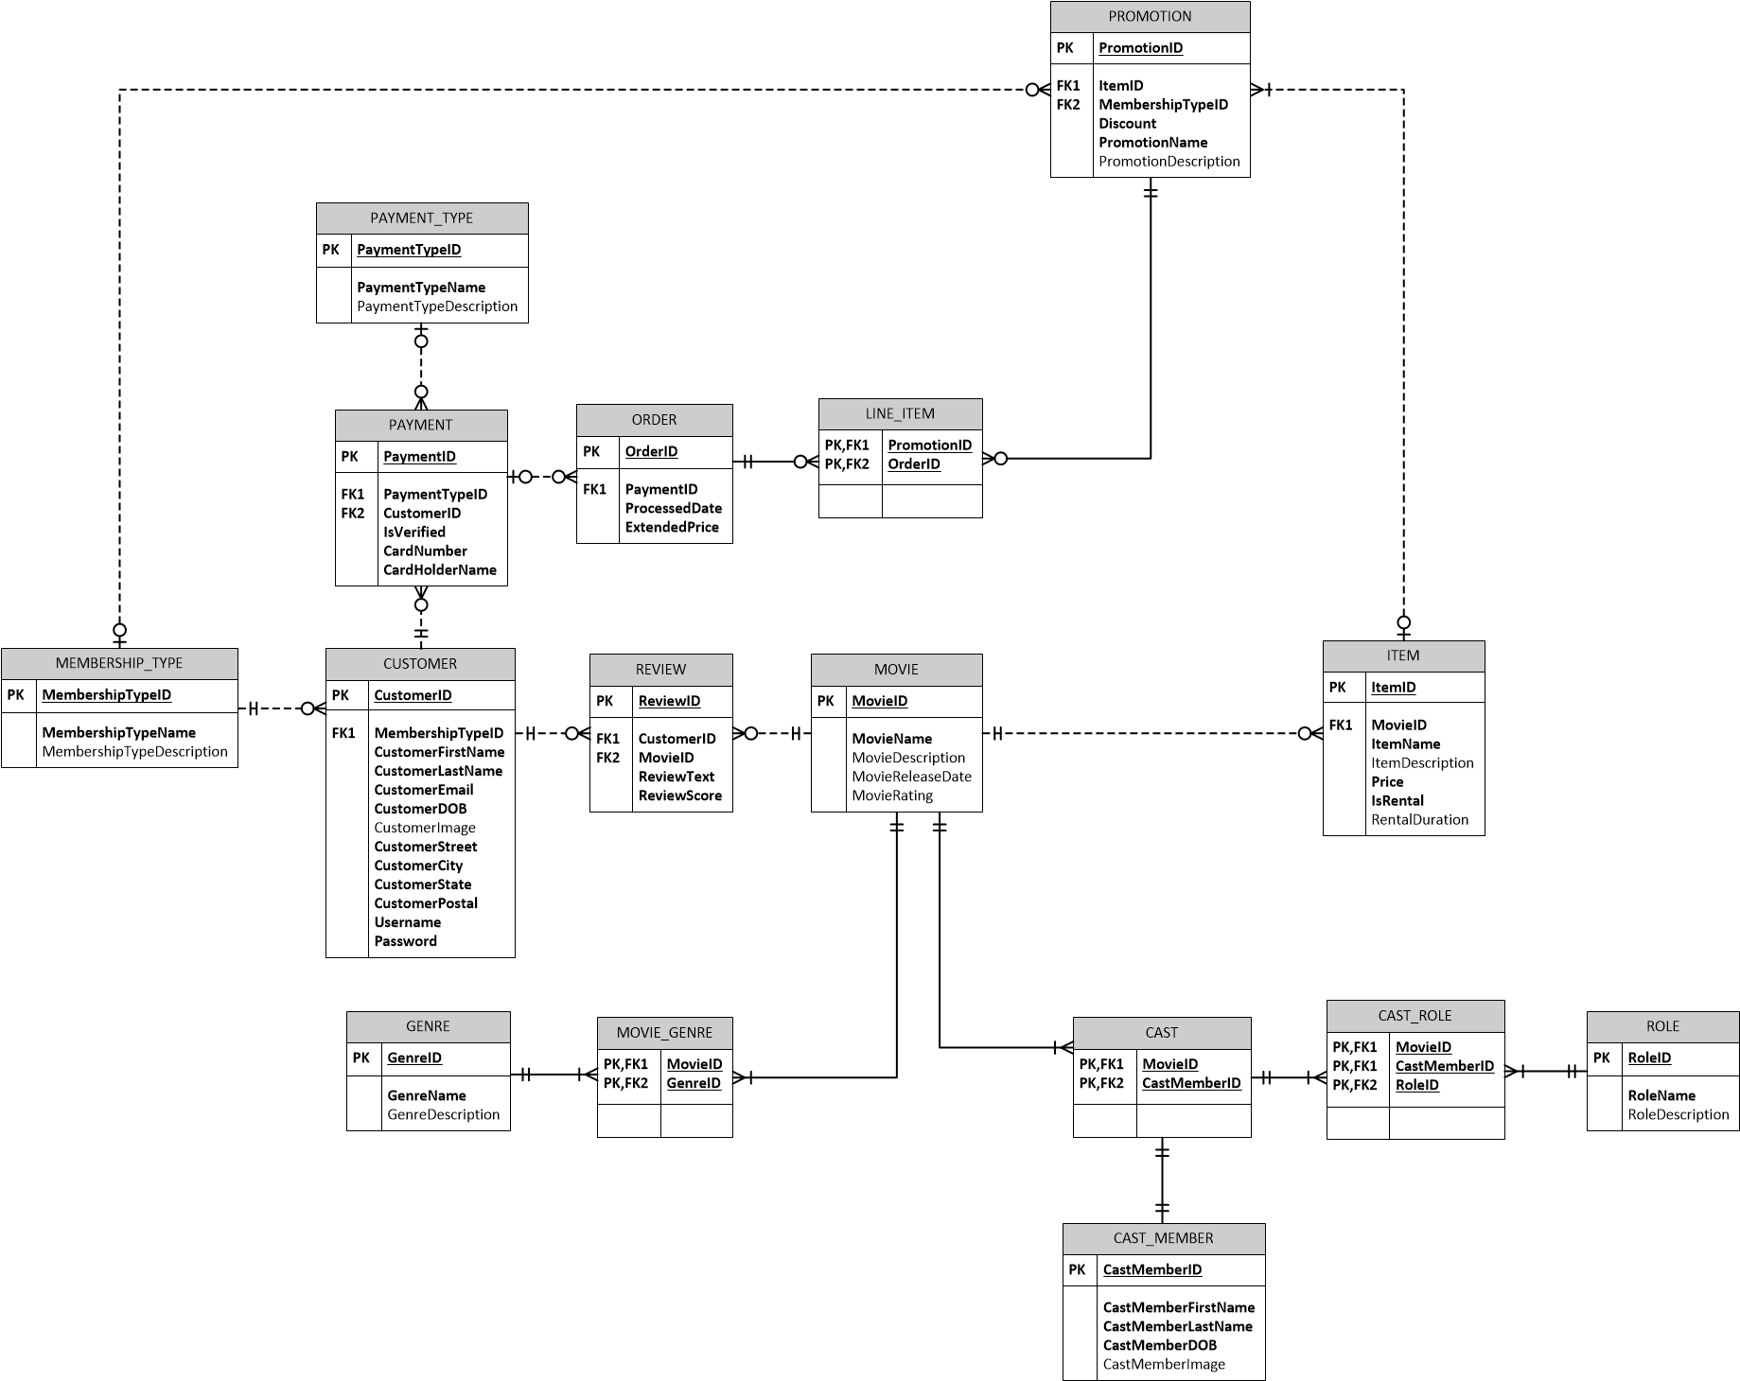
Initial Diagram
1

Slide 13
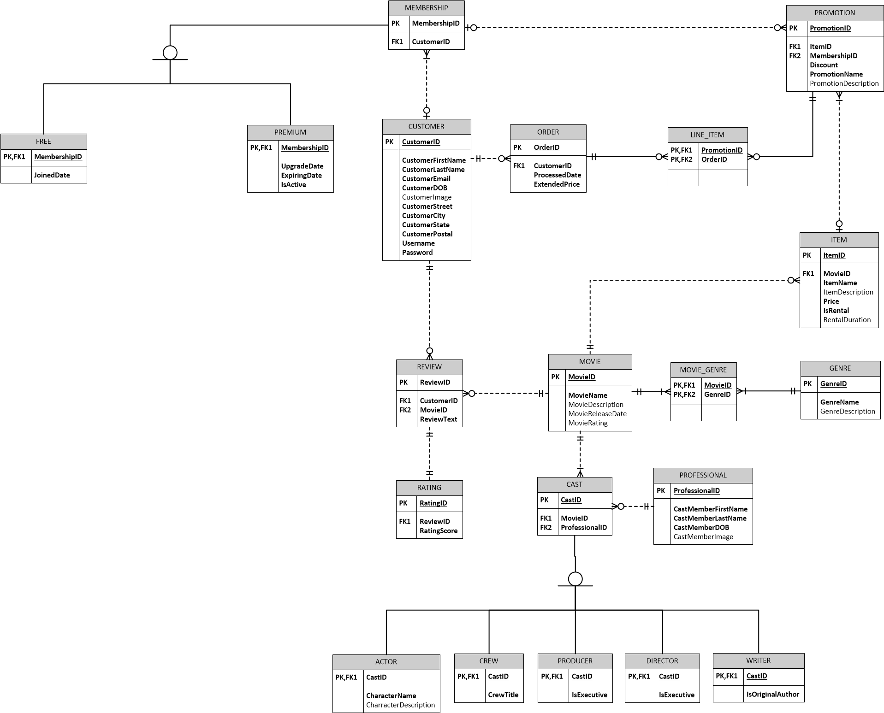
First Diagram Revision
2
Add table
[RATING]
Remove table
[PAYMENT_TYPE]
[PAYMENT]
Introduce subtype
[CAST] Subtypes
[MEMBERSHIP] Subtypes

Slide 14
First Diagram Revision
2
Rename table
[CAST_MEMBER] to [PROFESSIONAL]

Slide 15
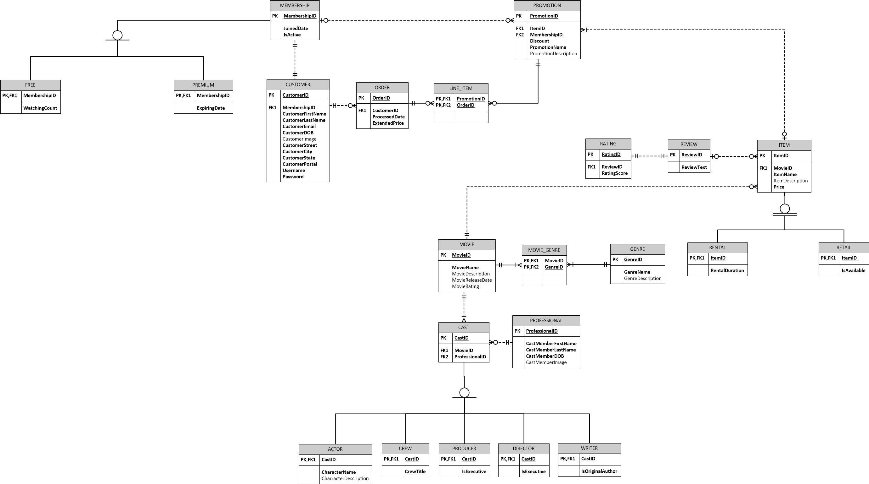
Second Diagram Revision
3
Introduce subtype
[ITEM] Subtypes
Eliminate outer referential loop

Slide 16
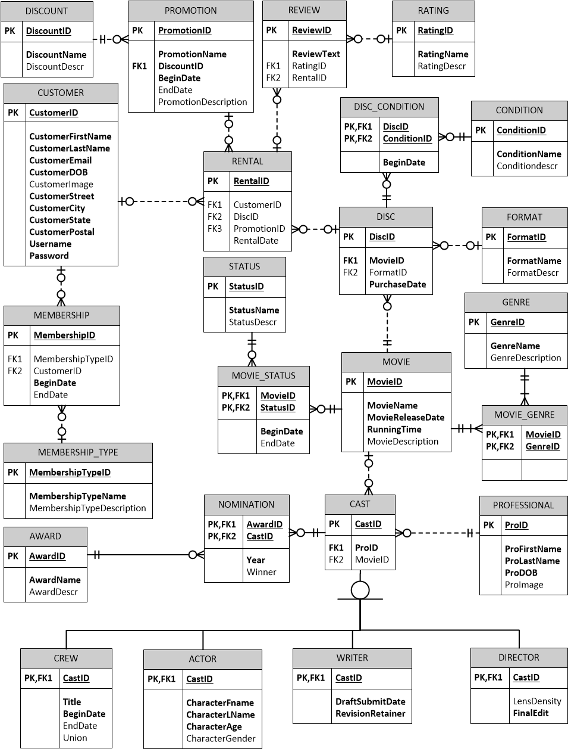
Finalized Diagram
3
Eliminate all referential loop
Add table to reflect change in business rule
[DISC]
[FORMAT]
[CONDITION]
[DISCOUNT]

Slide 17
Finalized Diagram
3
Add table to track additional movie information
[NOMINATION]
[AWARD]
[STATUS]

Slide 18
Database Demonstration
Procedures And Views

Slide 19
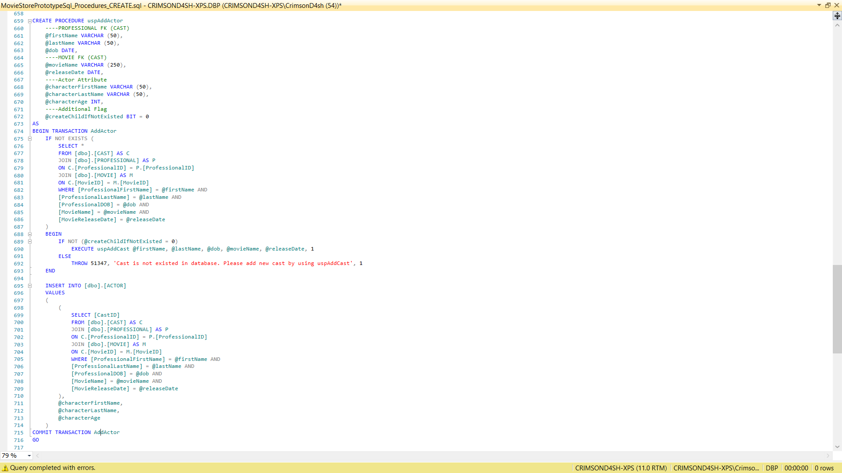
Insert Procedures

Slide 20
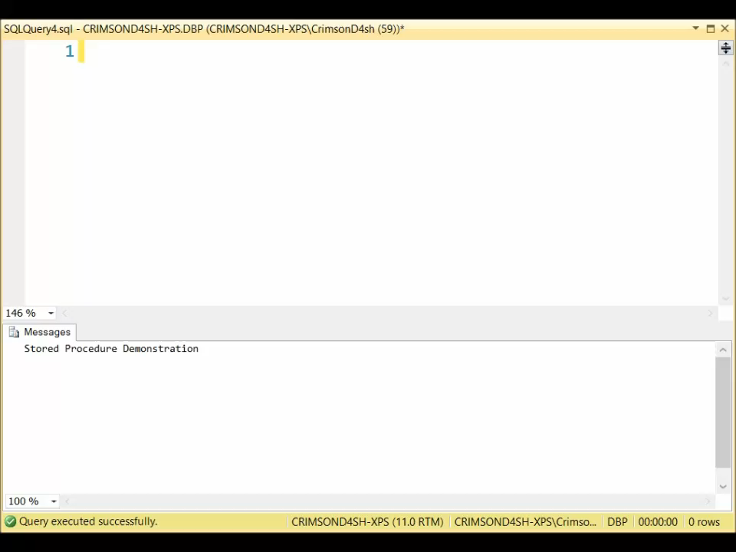
INSERT Procedures
Automatically populate related table if possible with @createChildIfNotExisted flag
Increase consistency by adding another layer of validation
Throw exceptions when foreign key(s) could not be found
Boost security by not having a user write the code from scratch

Slide 21
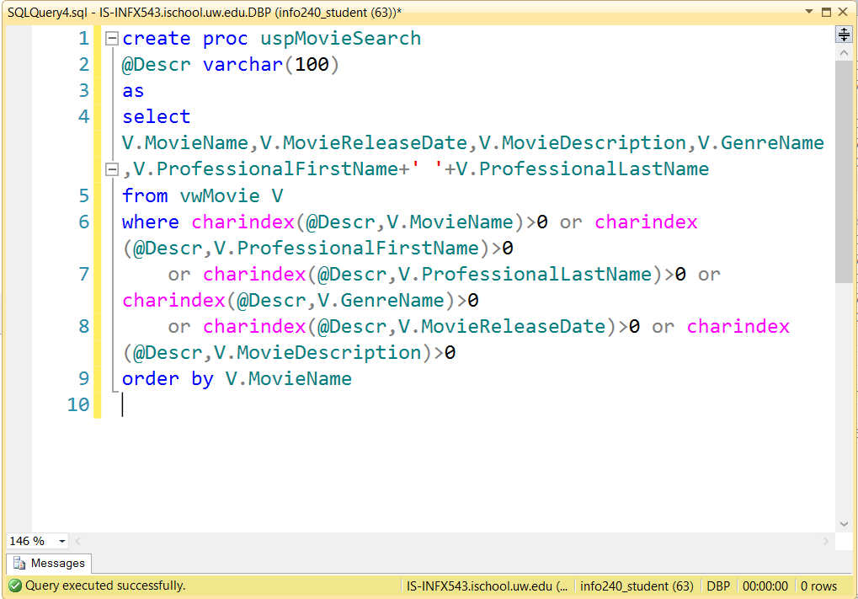
Movie Search Procedure

Slide 22
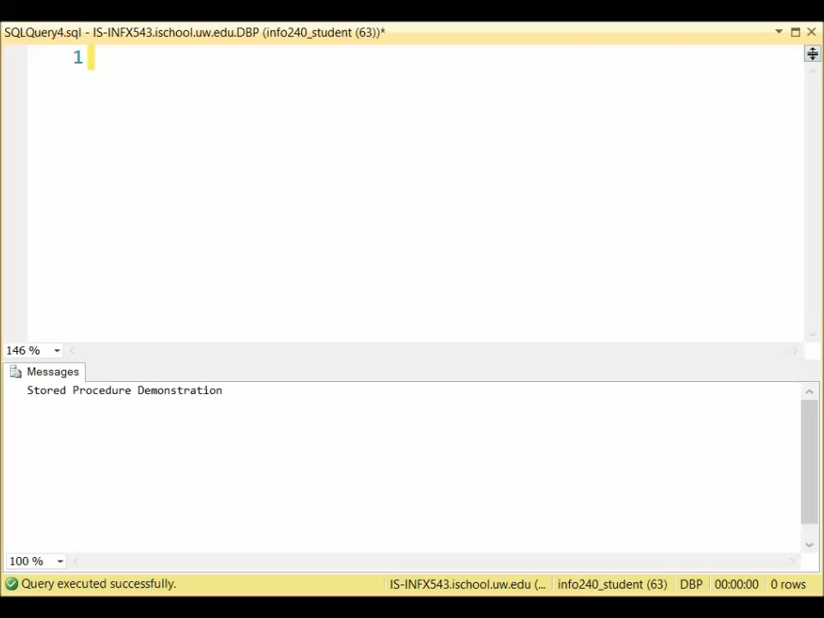
Movie Search Procedure
Search movie by keywords instead General Views of a column
Searching, Reviewing and Movie name
Character name
Released date

Slide 23
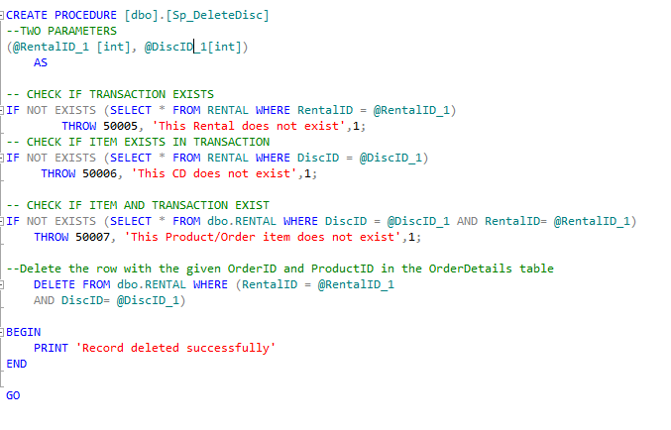
DELETE Disc Procedure

Slide 24
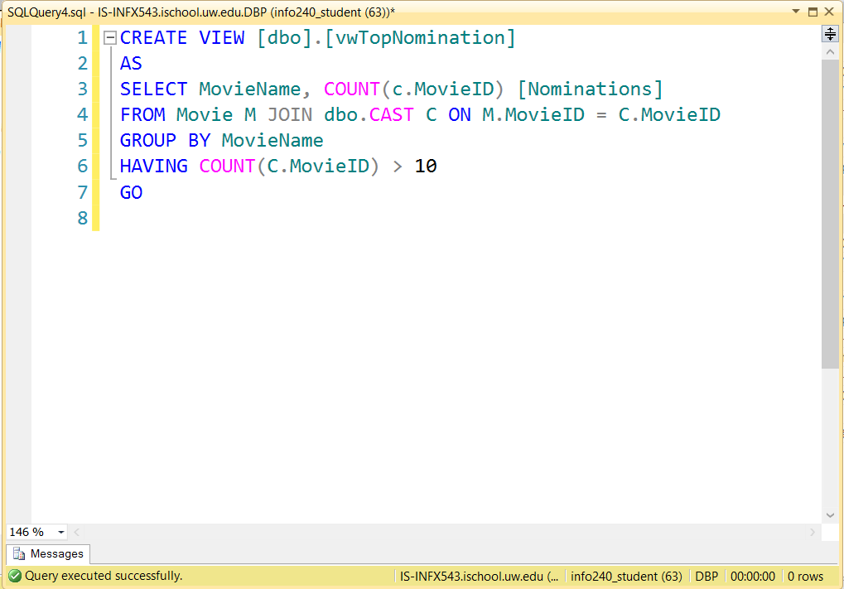
Top Nomination View

Slide 25
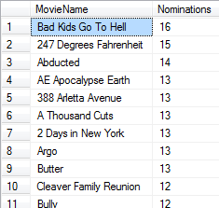
Top Nomination View

Slide 26

Other Implementations
View displaying general information of customer (personal information and rental)
View displaying general information of sales (movies and discount)

Slide 27
Thank you

